Slide 1

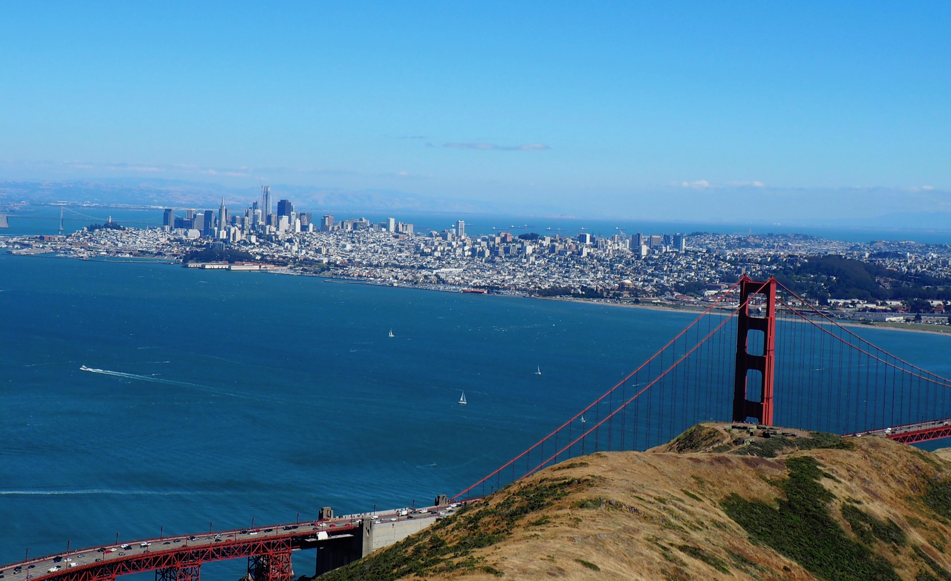
Battle Against Crime
In San FRANCISCO

Slide 2




Crime statistics
San Francisco crime statistics report an overall upward trend in crime based on data from 17 years with violent crime increasing and property crime increasing. This is as per report published at https://www.cityrating.com/crime-statistics/california/san-francisco.html

Slide 3
San Francisco has several police districts with varied types of crime in each district. This Project attempts to gather info on crime in the top neighborhoods on the various crime categories so that the San Francisco police department can focus on the neighborhoods that have the highest crime as per the year 2018 so that they can focus on creating task forces to address the same.

Slide 4
Methodology
The public data available at https://data.sfgov.org/Public-Safety/Police-Department-Incident-Reports-2018-to-Present/wg3w-h783 was used for the crime data of 2018 and also to explore neighborhoods in San Francisco with the top incidents.
The most common crime categories in each neighborhood was explored and then used to group the crime categories into clusters.
The k-means clustering algorithm was used to complete this task.
Finally, the Folium library was used to visualize the neighborhoods and incident categories in San Francisco and their clusters.

Slide 5
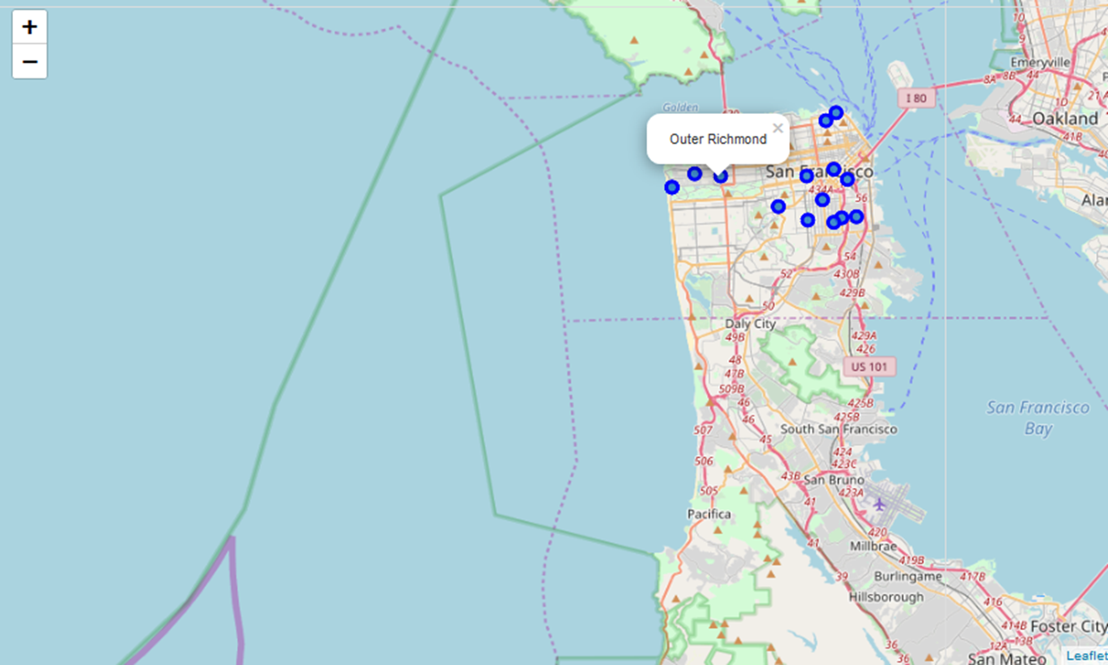
San Francisco shows all crime incidents concentrated in the northern parts for 2018 as per the report

Slide 6
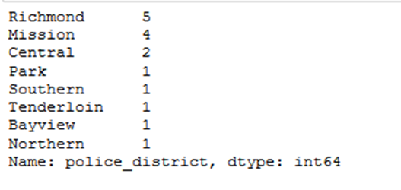
Richmond Police District showed the most incidents for 2018

Slide 7
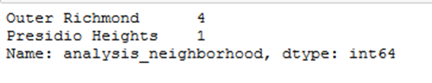
The top neighborhood in Richmond District was Outer Richmond. Presidio Heights was second.

Slide 8
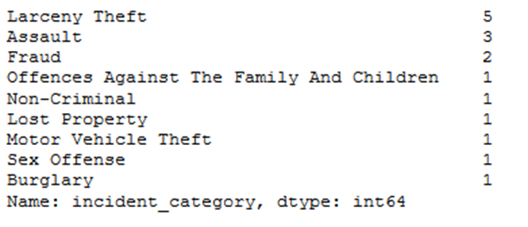
The top incident category was Larceny Theft in Richmond police district followed by Assault that came in second.

Slide 9
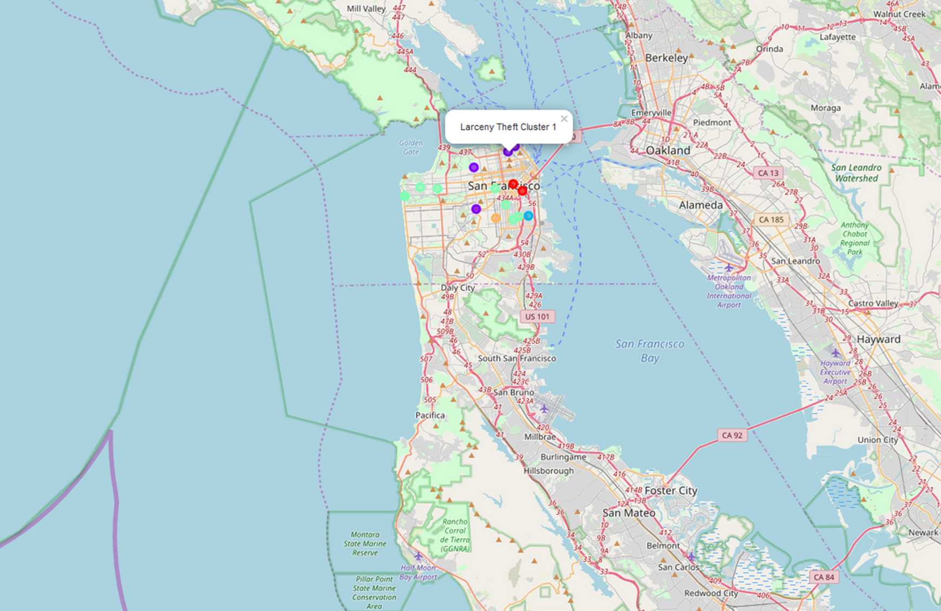
Clustering also shows more occurrences of Larceny theft(purple cluster) for the whole of San Francisco

Slide 10
Conclusion
The Battle against crime in San Francisco needs to start against Larceny Theft prioritizing the police district of Richmond.

